Slide 1
The ‘Come Alive’ collection of signature
experience at Sunlife.

Slide 2
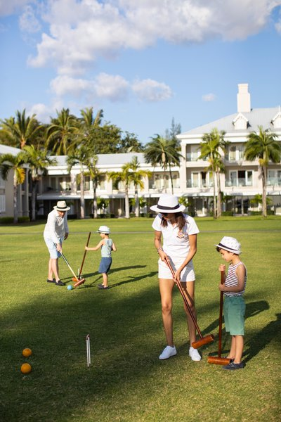
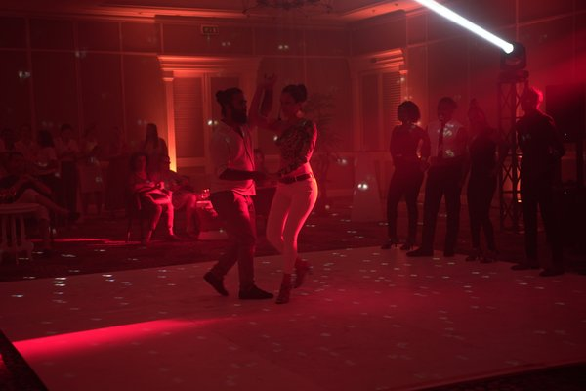
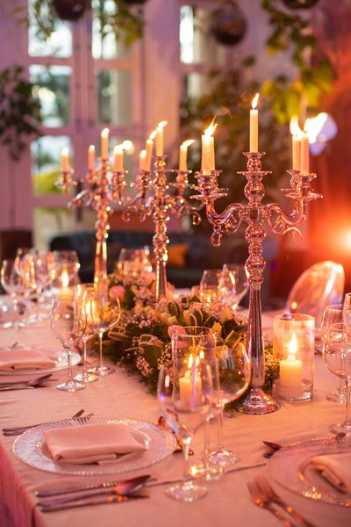
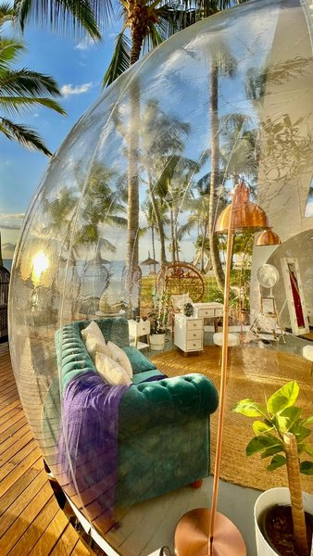
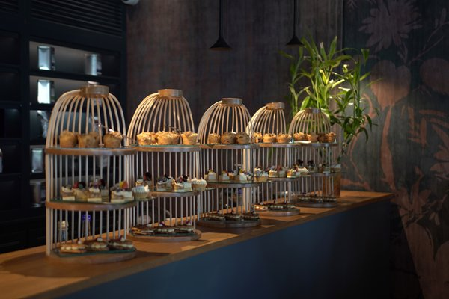
Come Alive Collection
Crazy Croquet
Bubble Beauty
Putting on the Ritz
Strictly Sugar
Time for Tea
L’ Atelier des sens

Slide 3
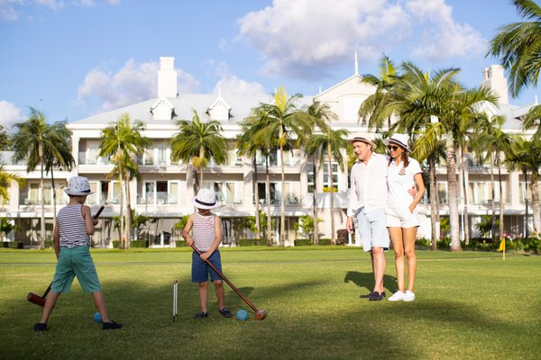
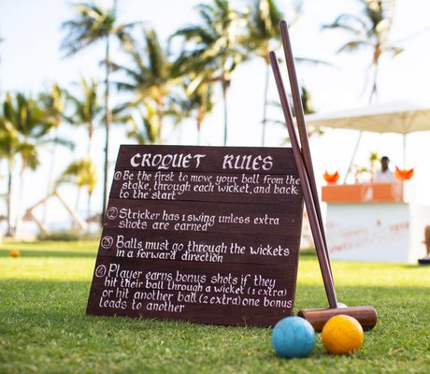
Crazy Croquet
Enjoy our beautiful lawn, with a glass of pale rose or a deeper hued Aperol Spritz as you hone your skills with mallet.
Pax : Approx 8 person per session.
Frequency : On Wednesdays with full set up + F&B.
Time: Varies.
Dress code : Strictly whites and Panama hats.
Duration: Approx 1hr30 min .
Drinks : Chargeable at a discount price (Happy Hour).

Slide 4
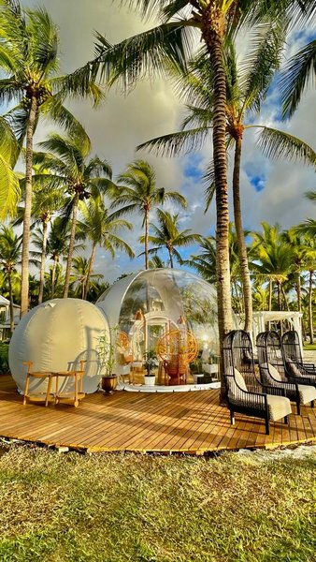
Beauty Bubble
A nail bar by day or a spa by night, our Beauty Bubble on the beach is an original way to combine pamper and play. While the Bubble’s therapist take care of you, a butler offers drinks from the trolley.
Pax : Approx 3 pax.
Frequency : Daily upon reservation as from 15:30 – 18:30.
Duration : Depending on the guest treatment booked.

Slide 5
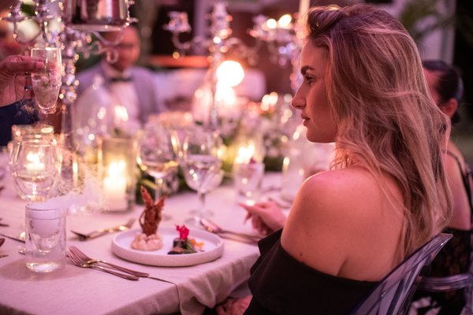
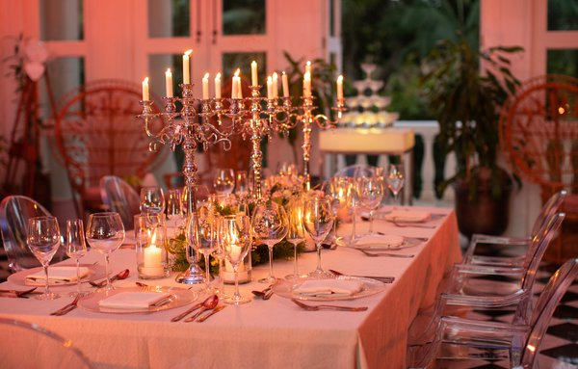
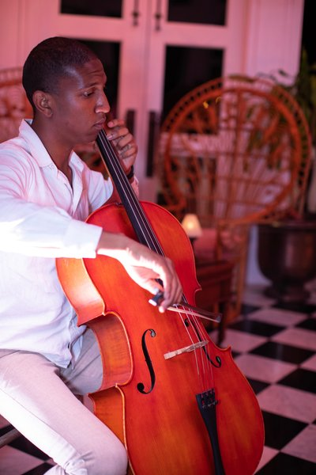
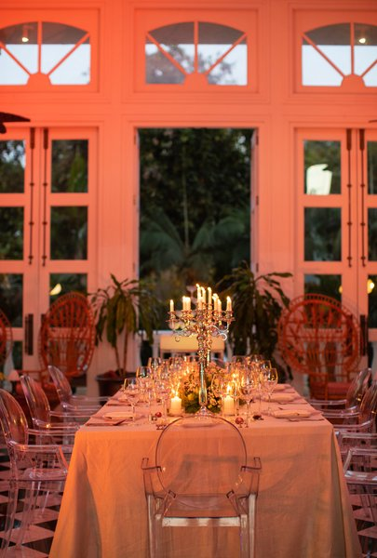
Putting on the Ritz
Sugar beach brings back the ‘Dress to impress’ sense of occasion so there’s no excuse not to get glammed up for dinner.
Pax : Approx 12 pax.
Frequency : Once a week.
Time: 19:00 – 22:00.
Duration : Approx 3hr .
Chargeble at MUR 3500 per person excluding drinks
Supplement –4500

Slide 6
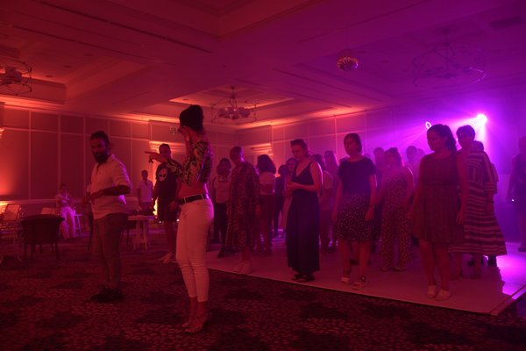
Strictly Sugar
Embrace your groove. Couples are shown by our experience instructors how to swing those arms and move those feet. All in a double quick time.
Approx : 12 pax for workshop.
Approx : 100 pax for ballroom dancing.
Frequency : Every Tuesday & Saturday at (16pm)Free of charge

Slide 7
Time for Tea
Escape the heat and enjoy a high tea experience in the Sugar Beach Tea lounge.
Approx : 12 pax.
Frequency : Wed, Fri, Sat.
Time: 15.30-17.00 (Upon reservation).
Duration : Approx 1hr.
Price : Rs 900 - Rs 1300. (including sparkling wine)

Slide 8
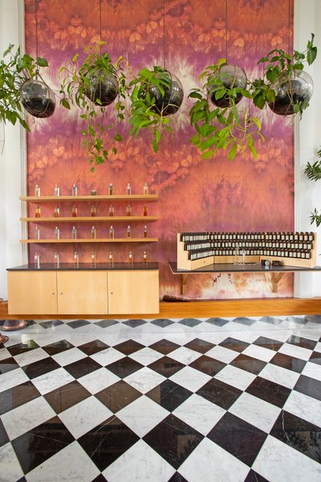
L’ Atelier des sens
An in-house perfume making workshop
during which guests discover the myriad
facets of essences while developing their
understanding of the history and culture of
perfume.
Approx : 6 pax.
Frequency: Daily upon reservation.
(except Sundays)
Time: 10.00 - 16.30.
Duration: Approx. 1hr30mins.
Price: Rs4000 per pax.

Slide 9
Thank you.

